Slide 1
Highly Available, Scalable, Secure & Cost-effective Web Application

Slide 2










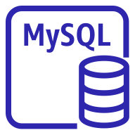

S3 Bucket (html, css, images, bootstrap script etc)
VPC
Elastic Load Balancing
Public Subnet
Availability Zone A
Availability Zone B
EC2
AMI
Bootstrap script
Auto Scaling Group
Private Subnet
Availability Zone A
Availability Zone B
IAM
Synchronous Replication
Primary DB Instance
Secondary DB Instance

